Slide 1
AUTOMATED IMAGE CAPTIONING USING ARTIFICIAL NEURAL NETWORKS
COE16B031
Under the guidance of Dr. J Umarani

Slide 2


What does the Image caption generator do?
Generates natural language descriptions of images and their regions
Smart Text Selection from the Images
Infer Correspondences between objects present in images

Slide 3
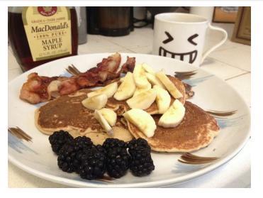
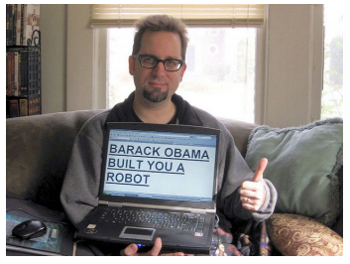
This is a scene in dining room or restaurant or bar. A breakfast plate with bacon, pancakes, bananas and blackberries.
MacDonald's is completely over bottle.
Maple Syrup is completely over bottle.
This is a scene in study room. A man holds a laptop that has a message about Barack Obama written on its screen.
Barack Obama built you a robot is completely over laptop.

Slide 4
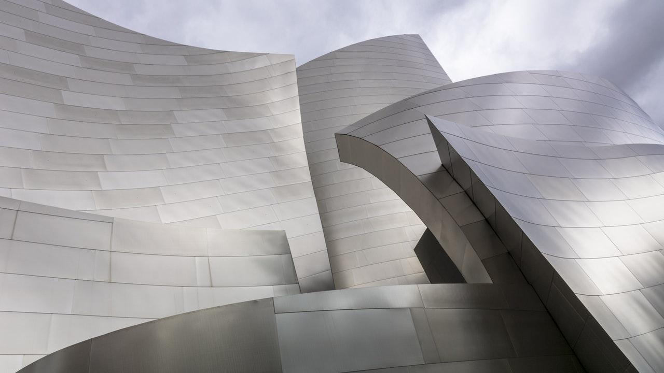
MOTIVATION
Image Captioning is a vital task relevant to the area of both Computer Vision and Natural Language Processing.
It can be used in various applications such as:
Highly beneficial to blind and visually impaired people (BVIP)
Betterment of Self Driving System
Enhancement of Alarm Generating Securing Systems
Assisting Google Image Search
Extension of Google Lens

Slide 5
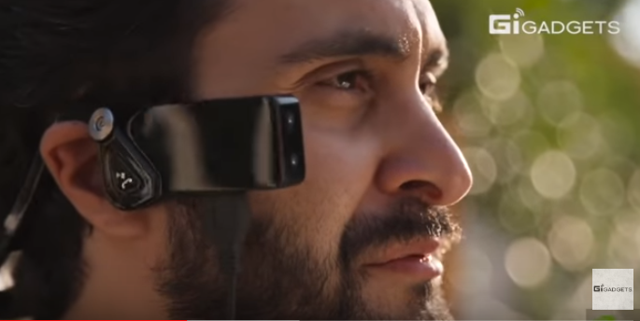
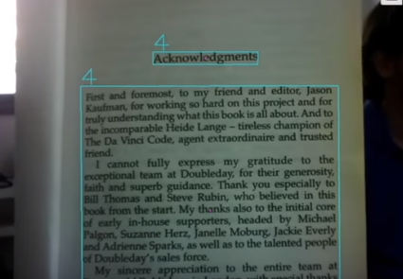
Acknowledgments

Slide 6
RELATED WORK
Retrieval based Image Captioning
Cosine Similarity
Template Based Image Captioning
→ Given a query image, retrieval based methods produce a caption for it.
→ The generated caption is either an already existing sentence or a sentence composed from the retrieved ones.
→ Project image and text items into a common space
→ In the new common space, cosine similarities between images and sentences are calculated to select top ranked sentences.
→ A speciﬁed set of visual concepts in an image need to be detected ﬁrst.
→The detected visual concepts are connected through sentence templates or speciﬁc language grammar rules to compose a sentence.

Slide 7
METHODOLOGY
Goal: Generate Descriptions of Image regions
Input to the model — Set of images and their corresponding descriptions
Image Dataset—Flickr8k dataset consisting of 8000 images with 5-descriptions each comprising to 40000 descriptions in total.
1. Learning to align to visual and language data
Encoding Image to Vector
Encoding Text to Vector
Alignment objective
Decoding text segment alignments to images
2. Recurrent Neural Network for generating descriptions
RNN training
RNN at test time
3. BLEU score (Bilingual Evaluation Understudy)

Slide 8
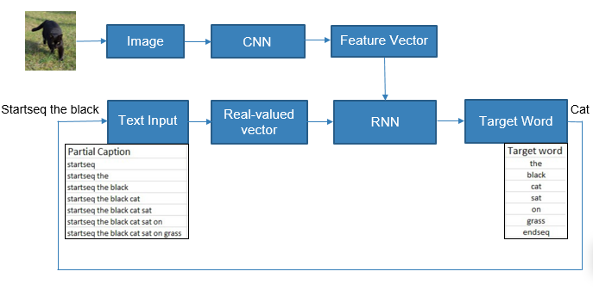
MODEL OVERVIEW
The input to the model is the image and the partial caption
The output is the target word

Slide 9
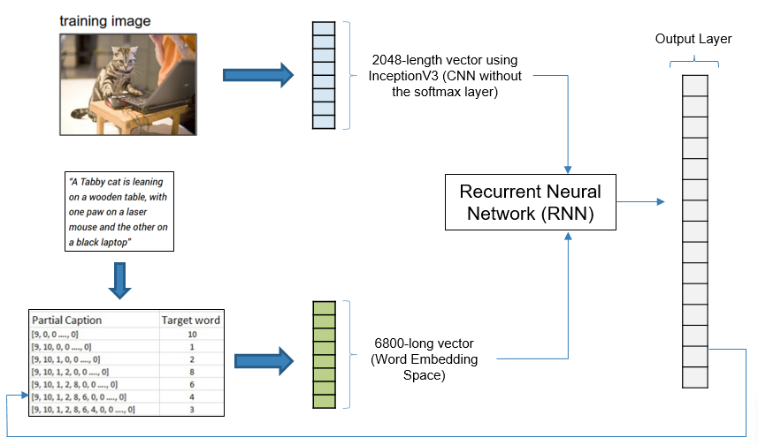
MODEL ARCHITECTURE
1652-length vector

Slide 10
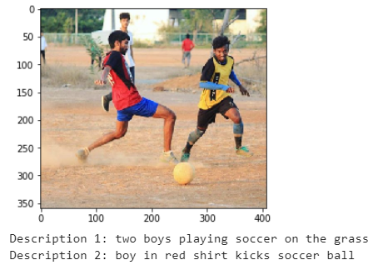
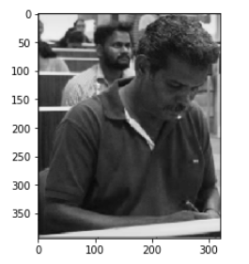

RESULTS-1

Slide 11
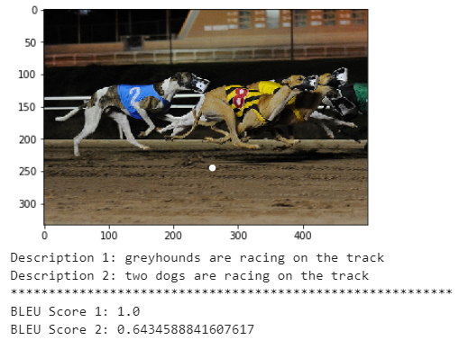
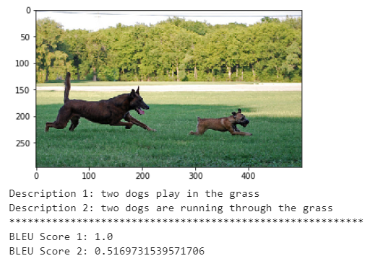
RESULTS-2

Slide 12
CONCLUSION
Built a model that generates natural language descriptions of images using integrated model architecture
Reported accuracy of this model using BLEU (Bilingual Evaluation Understudy)
BLEU scores machine translation hypotheses by aligning them to one or more reference translations
Achieved an average BLEU score of 0.71 on the existing Flickr8k dataset
In future work, the results of this model can be evaluated on neural machine translation or question answering
Also, other metrics such as METEOR and CIDEr can be used to overcome the shortcomings of BLEU

Slide 13
REFERENCES
[1] “Deep visual-semantic alignments for generating image descriptions,” [Online]. Available: https://cs.stanford.edu/people/karpathy/cvpr2015.pdf
[2] “A survey on automatic image caption generation,” [Online]. Available: https://www.sciencedirect.com/science/article/abs/pii/S0925231218306659
[3] “BLEU: Bilingual Evaluation Understudy,” [Online]. Available: https://arxiv.org/abs/1411.5726
[4] “Image captioning with keras,” in Medium. [Online]. Available: https://towardsdatascience.com/
[5] “Show and Tell: A Neural Image Caption Generator,” [Online]. Available: https://arxiv.org/abs/1411.4555v2

Slide 14
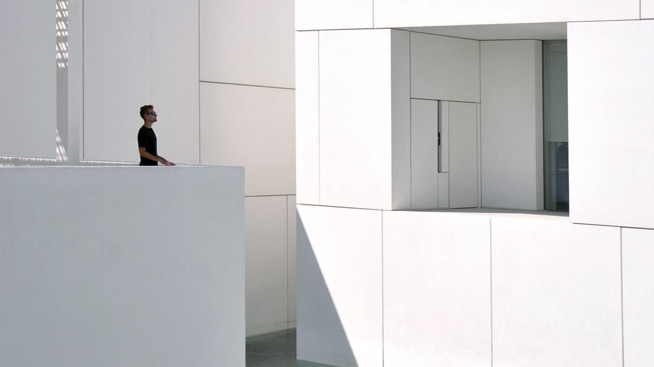
Thank You!
Any Questions?

